Slide 1



2025-04-11
OSS Strategy
Japan Local Meetup

Slide 2
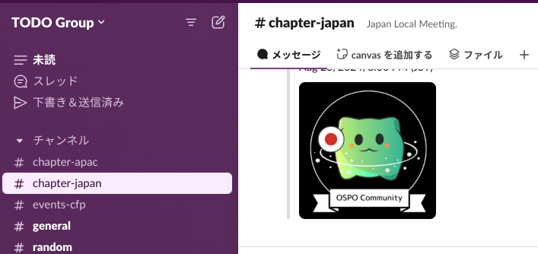
Administrative communication
Communication method
Slack: thetodogroup.slack.com
#chapter-japan
Materials
Slide material (this slide) https://docs.google.com/presentation/d/1lAGNvBQUm9YbMRoCJSxOqyE7jTagIBsv8Pa-IbR2ocY
Discussion sheet https://docs.google.com/spreadsheets/d/1vOwPrDIYrX29HshDwYsN1lAsQ4RcBOTEHIl9e5Oakxc
Weighting sheet https://docs.google.com/spreadsheets/d/1-3RHm92Xp_ES98AYW_bpPILn-dP9mXzsteFCtbhgk9c/
Since this is a personal account file, please do not insert images with large file sizes.

Slide 3
OSS Strategy & Hosting Activities
Last Updated 2024/10

Slide 4
OSS Strategy & Hosting
Business
cubic
OSS
Business Primary
Business
Secondary
OSS is essential to business
OSS itself does not generate profit
Profit is generated through OSS utilization
Businesses near and far from OSS A meeting to consider the relationship and discuss issues
*We will not discuss the following or how OSPO should be.
Rules and processes
KPI
Organization, internal structure, and internal collaboration
Compliance
Business
Secondary
Business
Tertiary
Notes:
OSS is essential to business
OSS itself does not generate profit
Profit is generated through OSS utilization
Businesses near and far from OSS
Think about the relationship between them,
and discuss issues
do not focus on discussion about internal rules, process samples related with OSS in company, OSPO KPI, etc.

Slide 5
OSS Strategy & Hosting
Imagine the challenges of OSS activities for companies (personas) that do business using OSS.
Linux distro vendor
Automotive and telecommunications industries
Semiconductor vendor
Online sales services
Cloud services (not under consideration)
OSS consulting services (not under consideration)
OSS contribution activities required are similar
However, the business impact of each activity varies
Notes:
Imagine the issues of OSS activities of companies (persona) who do business by leveraging OSS
Almost the same OSS contribution activity items required
However, the impact of each activity on the business is different.

Slide 6
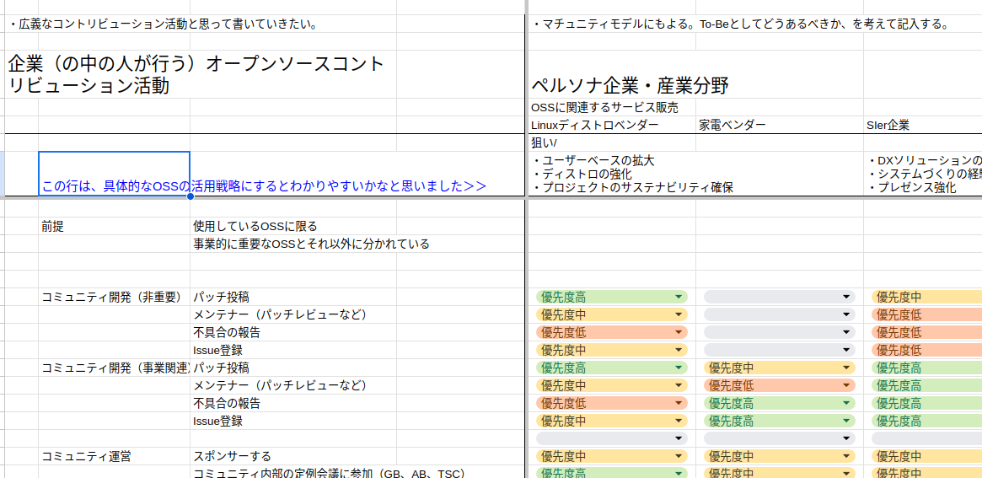
OSS Strategy & Hosting
contribution activity items and their impact in each persona company. We're discussing weighting
Join us! (URL)
Notes:
Discussing the weight of each contribution activity items and its impact per each persona company.
Please join us!

Slide 7
June Agenda
202504
6/13 (Fri) 15:00 ~
"Weighting of OSS Activities" objectives
We will organize the stacks and indicators of "objectives of persona companies and industrial fields (for organization)" and reorganize persona companies based on them
Based on the discussion until today, we will create a base for the reorganizing version of persona companies (Takanori)
Continuation of the discussion on how to organize

